Slide 1


The NGS Toolbox: Do I Need a Screwdriver or a Hammer?
nathan grubaugh

Slide 2
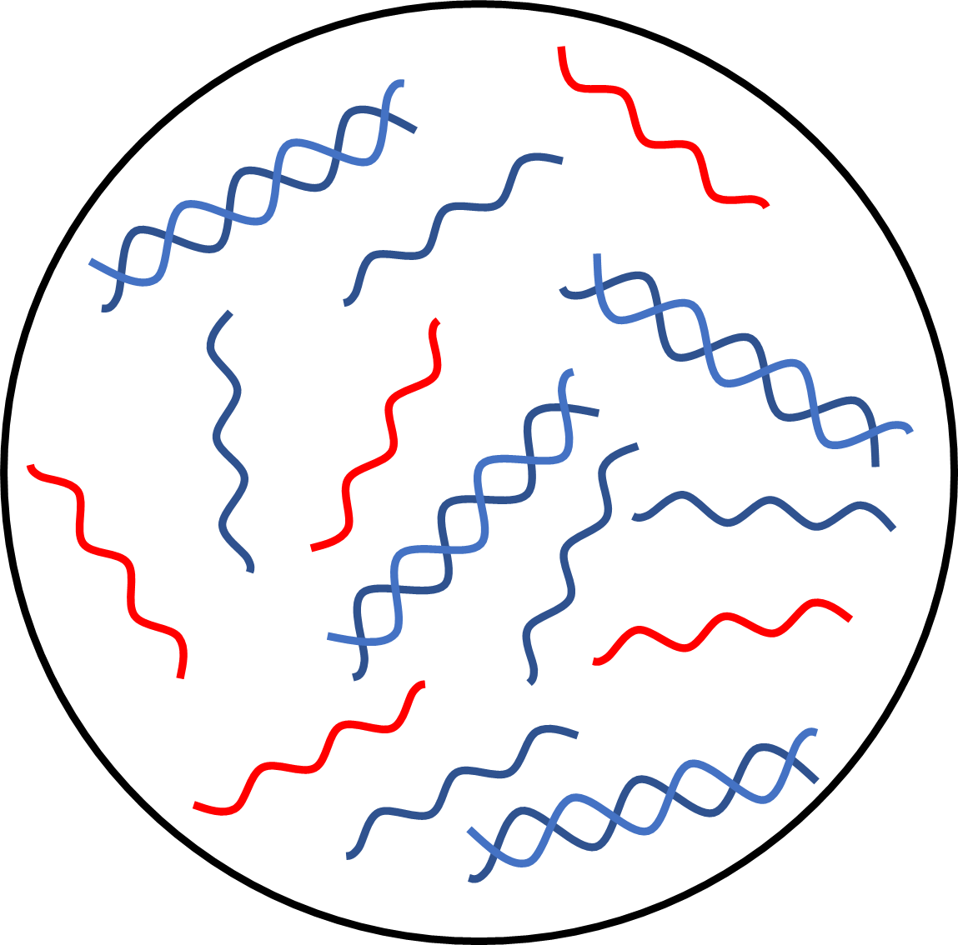

Total Nucleic Acid
Viral RNA
Host RNA
Host DNA

Slide 3
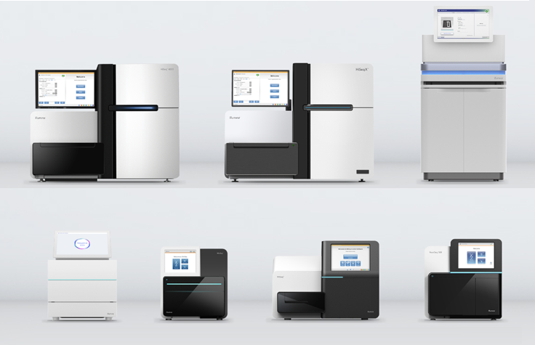
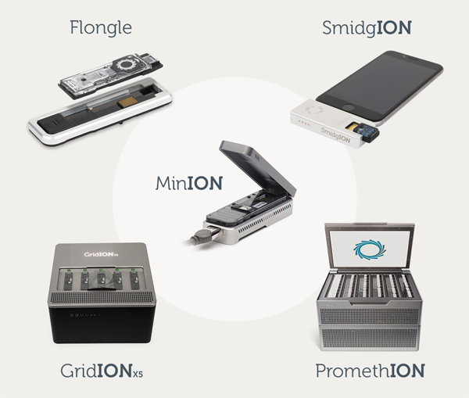
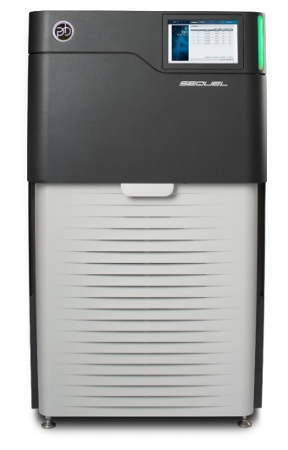
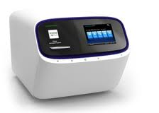
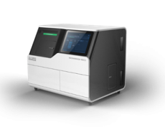
Nanopore
Illumina
Pacbio
Ion
BGI

Slide 4
Question + Samples + Resources = Tool

Slide 5
Question
What virus is in my sample?
Unknown – need unbiased method
Sequencing depth – need lots of data/sample
How is the virus evolving during an outbreak?
Known – can use a targeted method
Sample size – need to sequence lots of viruses
How is the virus evolving within a host?
Known – can use a targeted method if accurate
Sequencing depth – need lots of data/sample

Slide 6
Samples
Target to background ratio
Sample type and virus dependent (e.g. Zika virus in serum)
CT values, house-keeping genes, total nucleic acid, carrier RNA?
Determines unbiased versus targeted approach
Integrity
RNA/DNA extraction and storage
Determines read/amplicon lengths

Slide 7
Resources
Money $$
Do you have enough $$ to generate the required data?
Determines library prep and platform
Time
How quickly do you need the data?
Determines platform
Environment
Fully-equiped molecular biology lab? With personal sequencer?
Access to a genomics core?
In the field or other resource-limited environment?
What capacity do you have to analyze data?
Determines library prep and platform
Don’t be an ”Illumina Lab” just because you have a MiSeq

Slide 8
Question + Samples + Resources = Tool
Tool = Library prep + Sequencing platform

Slide 9
Tools – Library prep
Untargeted metagenomics
Sequence everything
Slightly biased additions
Dnase treatment
Host RNA depletion (e.g. rRNA)
Pros
Gold standard for pathogen sequencing (limited biases)
Do not need to know what you are looking for
Cons
Often requires lots of data/sample to cover target
Computationally challenging

Slide 10
Tools – Library prep
Targeted/enriched metagenomics
Sequence mostly target, but other stuff too
Examples
Spiked-primers during cDNA synthesis
Target capture probes pre or post library prep
Pros
Enhance target sequencing with minimal biases
Can scale for lots of potential targets (all DENV, all flaviviruses, all viruses)
Cons
Increases time, money, and skill of library prep

Slide 11
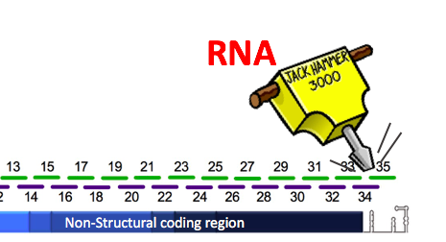
Tools – Library prep
Targeted PCR amplification
Sequence only target
Examples
16S for bacteria
Overlapping multiplexed for near-complete virus genomes (PrimalSeq)
Pros
Cheap and easy
Scalable for generating large datasets
Requires minimal sequencing data
Cons
Biased amplification
Easy to contaminate

Slide 12
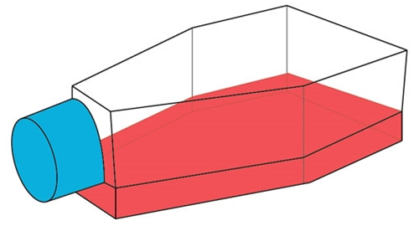
Tools – Library prep
Cell culture selection
Enrich for virus in cells prior to standard sequencing
Still commonly used in surveillance programs
Pros
Broad enrichment for viruses that easily replicate in culture
Mostly virus RNA, requires minimal sequencing data
Cheap
Cons
Biased virus composition (among species and intra-host populations)
Potential for cell culture adaptations

Slide 13
Tools – Sequencing platform
Large-Scale
E.g., Illumina NovaSeq, HiSeq; PacBio; Nanopore PromethION
Most data/$, but expensive per run
Not affordable by most individual labs (genomics cores)
Mid-Scale
E.g., Illumina MiSeq, NextSeq; Ion Torrent; Nanopore GridION
mid data/$
Affordable by some individual labs, requires maintenance
Portable
E.g., Illumina iSeq; BGI DNBseq; Nanopore MinION
Low data/$, but cheap per run
Affordable and can be set up in many locations

Slide 14
Tools – Sequencing platform
Platform | Expected Yield (Gb) | Seq Kit Cost | Estimated Cost/Gb
Illumina iSeq | 1 | $600 | $600.00
Illumina MiSeq | 15 | $1,625 | $108.33
Illumina HiSeq | 1500 | $6,810 | $4.54
Illumina NovaSeq | 6000 | $5,500 | $0.92
ONT MinION | 10 | $675 | $67.50
ONT GridION | 150 | $3375 | $22.50
ONT PromethION | 3800 | $19,200 | $5.05

Slide 15
Tools – Sequencing platform
Illumina
MiSeq/NovaSeq
Accurate sequencing, short reads
Good for generating lots of data (NovaSeq)
Expensive to run and maintain
Uses:
Large projects (samples in home lab)
Accurate sequencing (intrahost, metagenomics)
Long reads, error prone
Good for generating quick data
Rugged, cheap to run (reusable flowcells)
Uses:
Field or limited resources
Lab for long reads and quick data

Slide 16
Controls + accuracy
Controls
Negative controls at important steps (sample collection, RNA extraction, PCR, etc)
“Healthy” or environmental controls (metagenomics to determine background)
Internal controls to measure efficiency of library prep and validate sequencing
Normalize input target concentrations (important for comparing intrahost diversity)
Improving accuracy
Dual-indexes (reduces “index” hopping)
High-fidelity polymerases (reduces library prep errors)
Sequence technical replicates (removes sequencing errors)
Unique molecular identifiers (UMIs, removes sequencing errors)

Slide 17
Scenarios
Question
Clinical metagenomics for unknown causes of encephalitis (population study, not for diagnostics)
Samples
Cerebral spinal fluid, maintained on cold chain
Hundreds of samples
Resources
Well funded clinical lab (not much NGS experience)
Access to Genomics Core
Not time sensitive
Tools?
Library prep
Platform

Slide 18
Scenarios
Question
Investigating 2019 dengue virus outbreak in Honduras
Samples
Serum, low CTs, somewhat degraded
Hundreds of samples
Resources
Mobile lab
Need data fast
Tools?
Library prep
Platform

Slide 19
Scenarios
Question
Evaluating Zika virus antibody escape in non-human primates (research)
Samples
Serum, high CTs
Dozens of samples
Resources
Experienced, well funded molecular biology lab
No on-site genomics core
Tools?
Library prep
Platform

Slide 20
Scenarios
Question
Are two mutations ~500nt apart co-occurring on the same virus genome (pilot study)?
Samples
Cell culture supernatant, mixed infections
Few samples
Resources
Basic molecular lab
Need data fast for PhD committee meeting
Tools?
Library prep
Platform

Slide 21
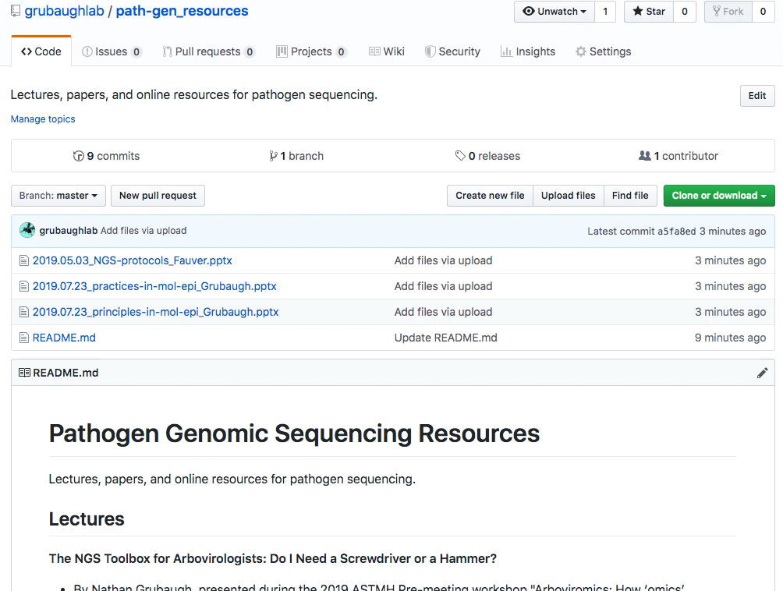
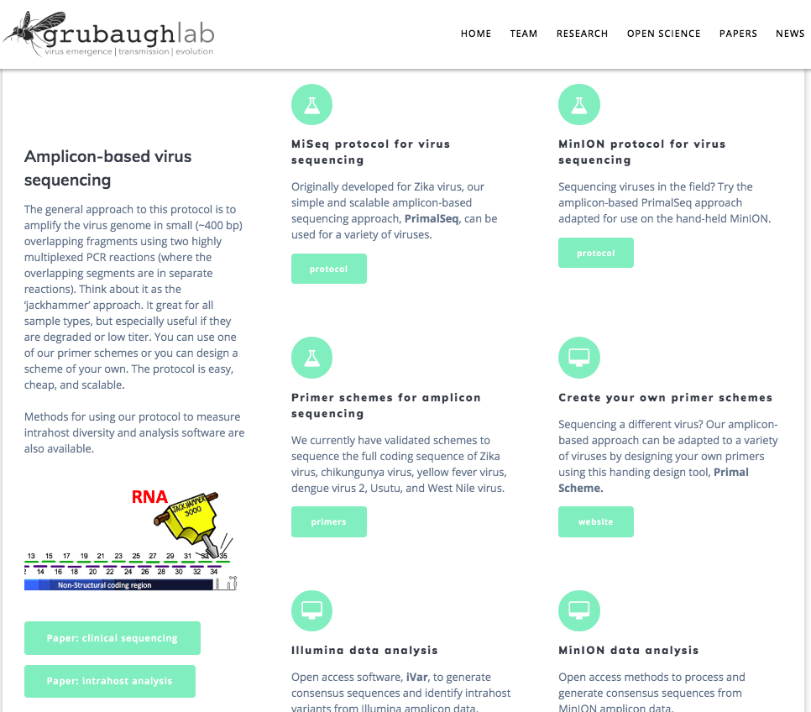
github.com/grubaughlab/path-gen_resources

